Slide 1
Lecture 01 Analysis of algorithms
CSE373: Design and Analysis of Algorithms

Slide 2
Course Objective
The theoretical study of design and analysis of computer algorithms
Analysis: predict the cost of an algorithm in terms of resources and performance
Design: design algorithms which minimize the cost

Slide 3
Definition
In simple terms, an algorithm is a series of instructions to solve a problem (complete a task)
Problems can be in any form
Business
Get a part from Dhaka to Sylhet by morning
Allocate manpower to maximize profit
Life
I am hungry. How do I order pizza?
Explain how to tie shoelaces to a five year old child

Slide 4
Definition
An algorithm is a finite set of precise instructions for performing a computation or for solving a problem.
It must produce the correct result
It must finish in some finite time
You can represent an algorithm using pseudocode, flowchart, or even actual code

Slide 5
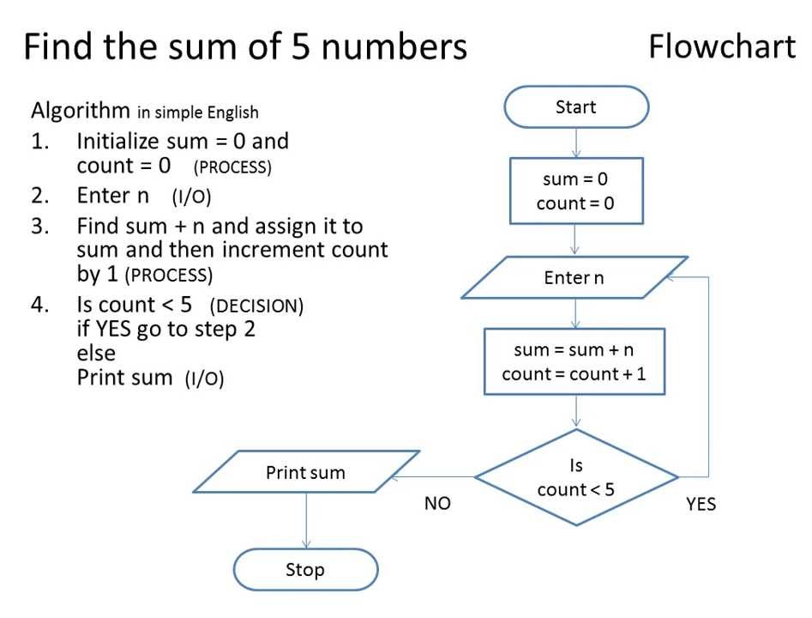
Algorithm Description

Slide 6
The Problem of Sorting
Input: sequence ⟨a₁, a₂, …, a_{n}⟩ of numbers.
Output: permutation ⟨a'₁, a'₂, …, a'_{n}⟩ such
that a'₁ ≤ a'₂ ≤ … ≤ a'_{n} .
Example:
Input: 8 2 4 9 3 6
Output: 2 3 4 6 8 9

Slide 7
Insertion Sort
INSERTION-SORT (A, n) ⊳ A[1 . . n]
for j ← 2 to n
do key ← A[ j]
i ← j – 1
while i > 0 and A[i] > key
do A[i+1] ← A[i]
i ← i – 1
A[i+1] = key
“pseudocode”
1
i
j
n
A:
key
sorted

Slide 8
Example
8
2
4
9
3
6

Slide 9
Example
8
2
4
9
3
6

Slide 10
Example
8
2
4
9
3
6
2
8
4
9
3
6

Slide 11
Example
8
2
4
9
3
6
2
8
4
9
3
6

Slide 12
Example
8
2
4
9
3
6
2
8
4
9
3
6
2
4
8
9
3
6

Slide 13
Example
8
2
4
9
3
6
2
8
4
9
3
6
2
4
8
9
3
6

Slide 14
Example
8
2
4
9
3
6
2
8
4
9
3
6
2
4
8
9
3
6
2
4
8
9
3
6

Slide 15
Example
8
2
4
9
3
6
2
8
4
9
3
6
2
4
8
9
3
6
2
4
8
9
3
6

Slide 16
Example
8
2
4
9
3
6
2
8
4
9
3
6
2
4
8
9
3
6
2
4
8
9
3
6
2
3
4
8
9
6

Slide 17
Example
8
2
4
9
3
6
2
8
4
9
3
6
2
4
8
9
3
6
2
4
8
9
3
6
2
3
4
8
9
6

Slide 18
Example
8
2
4
9
3
6
2
8
4
9
3
6
2
4
8
9
3
6
2
4
8
9
3
6
2
3
4
8
9
6
2
3
4
6
8
9
done
How can you modify this algorithm so that it sorts numbers in reverse order?

Slide 19
Analysis of Algorithms
What does it mean to analyze an algorithm?
To have an estimate about how much time an algorithm may take to finish, or in other words, to analyze its running time
Sometimes, instead of running time, we are interested in how much memory the algorithm may consume while it runs
It enables us to compare between two algorithms
What do we mean by running time analysis?
Also referred to as time-complexity analysis
To determine how running time increases as the size of the problem increases.

Slide 20
Analysis of Algorithms
Size of the problem can be a range of things, including
size of an array
polynomial degree of an equation
number of elements in a matrix
number of bits in the binary representation of the input
.
.
and so on…

Slide 21
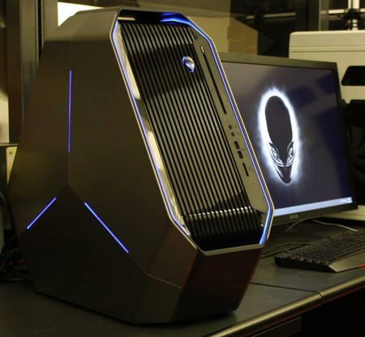
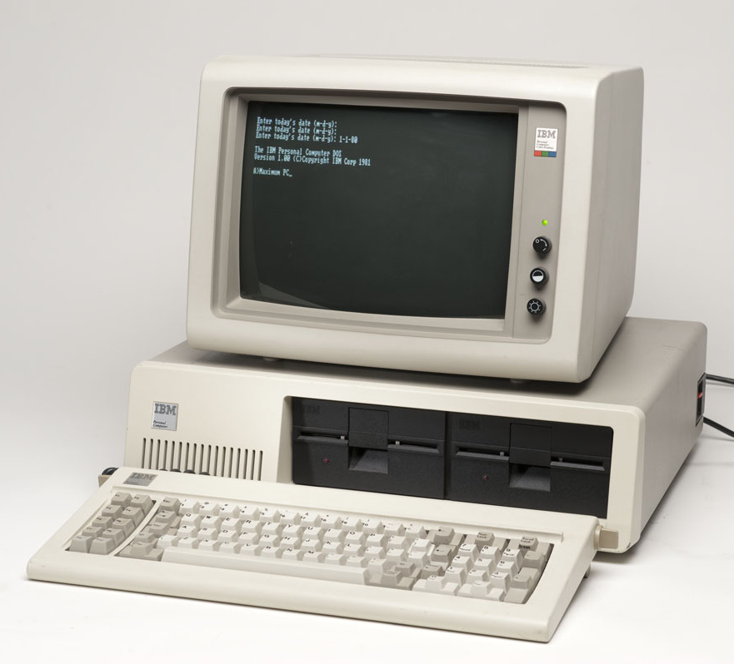
How Do We Analyze Running Time?
We need to define an objective measure.
(1) Compare execution times?
Not good: times are specific to a particular computer !!

Slide 22
How Do We Analyze Running Time?
We need to define an objective measure.
(2) Count the number of statements executed?
Associate a "cost" with each statement.
Find the "total cost“ by finding the total number of times each statement is executed.
Not good: number of statements vary with the programming language as well as the style of the individual programmer.
Algorithm 1
Cost
arr[0] = 0; c₁
arr[1] = 0; c₁
arr[2] = 0; c₁
...
arr[N-1] = 0; c₁
----------------------c₁+c₁+...+c₁ = c₁N
Algorithm 2
Cost
for(i=0; i<N; i++) c₁+c₂(N+1)+ c₃N
arr[i] = 0; c₁N
-----------------------------
c₁+c₂(N+1)+c₃N+c₁N = (c₁+c₂+c₃)N+(c₁+c₂)
c₁
c₂
c₃

Slide 23
Insertion Sort
INSERTION-SORT (A, n) ⊳ A[1 . . n]
for j ← 2 to n
do key ← A[ j]
i ← j – 1
while i > 0 and A[i] > key
do A[i+1] ← A[i]
i ← i – 1
A[i+1] = key
What is the estimated running time?
Depends on arrangement of numbers in the input array. We are typically interested in the runtime of an algorithm in the worst case scenario.
Because it provides us a guarantee that the algorithm won’t take any longer than this for any type of input.
How can you arrange the input numbers so that this algorithm becomes most inefficient (worst case)?

Slide 24
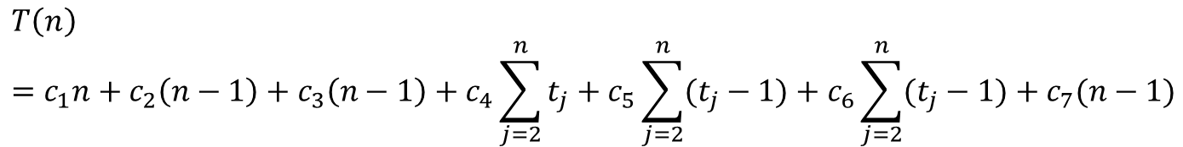
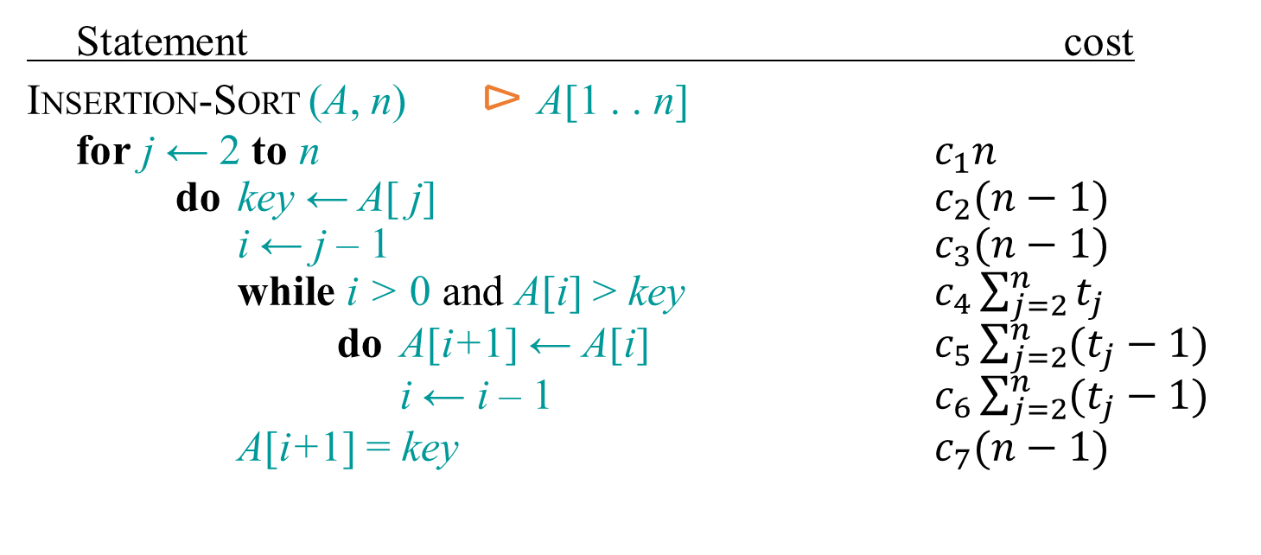
Insertion Sort: Running Time
Statement cost
INSERTION-SORT (A, n) ⊳ A[1 . . n]
for j ← 2 to n $c_{1}n$
do key ← A[ j] $c_{2}(n−1)$
i ← j – 1 $c_{3}(n−1)$
while i > 0 and A[i] > key $c_{4}\sum_{j=2}^{n}{t_{j}}$
do A[i+1] ← A[i] $c_{5}\sum_{j=2}^{n}{(t_{j}−1)}$
i ← i – 1 $c_{6}\sum_{j=2}^{n}{(t_{j}−1)}$
A[i+1] = key $c_{7}(n−1)$
$$T\left(n\right)={c_{1}n+c}_{2}\left(n−1\right)+c_{3}\left(n−1\right)+c_{4}\sum_{j=2}^{n}{t_{j}}+c_{5}\sum_{j=2}^{n}{(t_{j}−1)}+c_{6}\sum_{j=2}^{n}{(t_{j}−1)}+c_{7}(n−1)$$
Here t_{j} = no. of times the condition of while loop is tested for the current value of j.
In the worst case (when input is reverse-sorted), in each iteration of the for loop, all the j-1 elements need to be right shifted and the key will be inserted in the front of them, i.e., t_{j}=j-1. Putting this in the above equation, we get: T(n) = An²+Bn+C, where A, B, C are constants.
What is T(n) in the best case (when the input numbers are already sorted)?

Slide 25
Ideal Solution
Express running time as a function of the input size n (i.e., f(n)).
Compare different functions of running times in an asymptotic manner.
Such an analysis is independent of machine type, programming style, etc.

Slide 26
Asymptotic Analysis
To compare two algorithms with running times f(n) and g(n), we need a rough measure that characterizes how fast each function grows.
Hint: use rate of growth
Compare functions in the limit, that is, asymptotically!
(i.e., for large values of n)

Slide 27
Rate of Growth
Consider the example of buying elephants and goldfish:
Cost: cost_of_elephants + cost_of_goldfish
Cost ~ cost_of_elephants (approximation)
The low order terms, as well as constants in a function are relatively insignificant for large n
6n + 4 ~ n
n⁴ + 100n² + 10n + 50 ~ n⁴
i.e., we say that n⁴ + 100n² + 10n + 50 and n⁴ have the same rate of growth

Slide 28
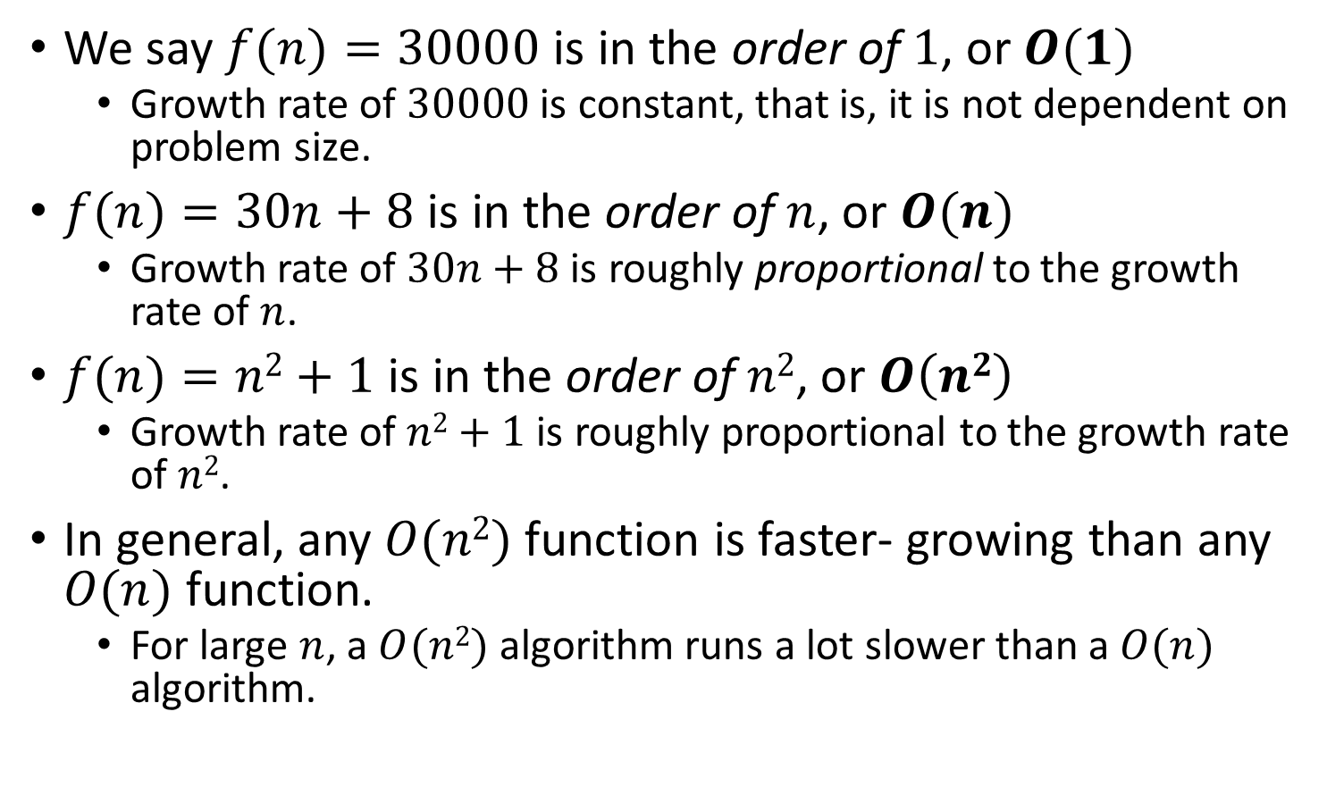
Big-O Notation
We say $f(n)=30000$ is in the order of $1$, or $O(1)$
Growth rate of $30000$ is constant, that is, it is not dependent on problem size.
$f(n)=30n+8$ is in the order of $n$, or $O(n)$
Growth rate of $30n+8$ is roughly proportional to the growth rate of $n$.
$f(n)=n2+1$ is in the order of $n2$, or $O\left(n2\right)$
Growth rate of $n2+1$ is roughly proportional to the growth rate of $n2$.
In general, any $O(n2)$ function is faster- growing than any $O(n)$ function.
For large $n$, a $O(n2)$ algorithm runs a lot slower than a $O(n)$ algorithm.

Slide 29
Visualizing Orders of Growth
On a graph, as you go to the right, a faster growing function eventually becomes larger.
f_{A}(n)=30n+8
Running time→
f_{B}(n)=n²+1
Increasing n →

Slide 30
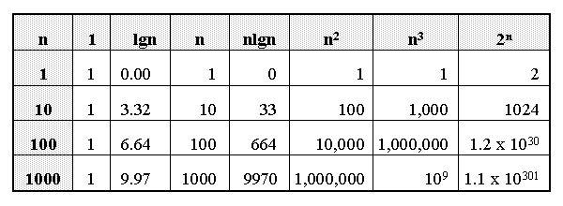
Growth of Functions

Slide 31
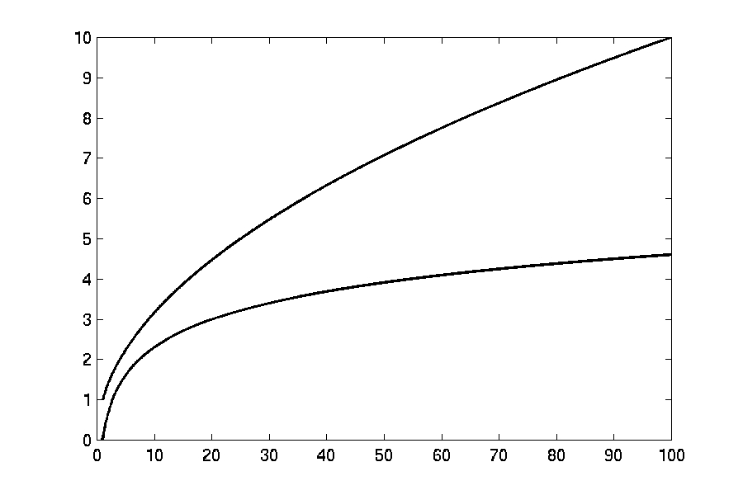
Complexity Graphs
log(n)

Slide 32
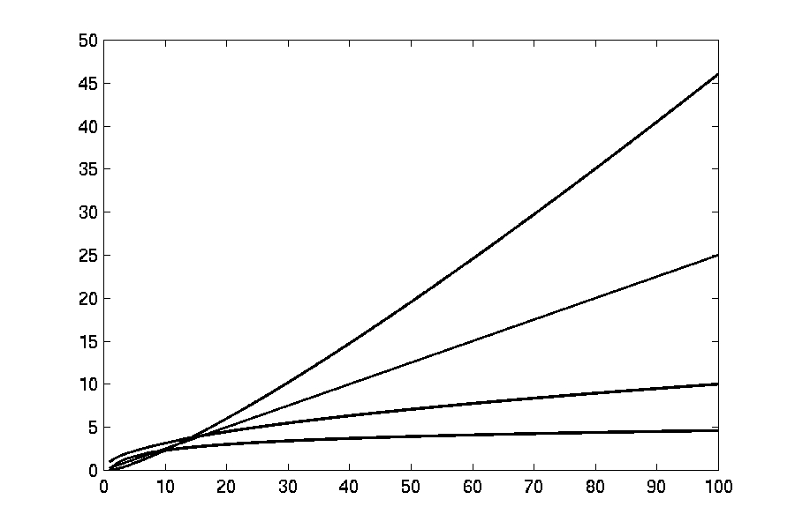
Complexity Graphs
n log(n)
n
log(n)

Slide 33
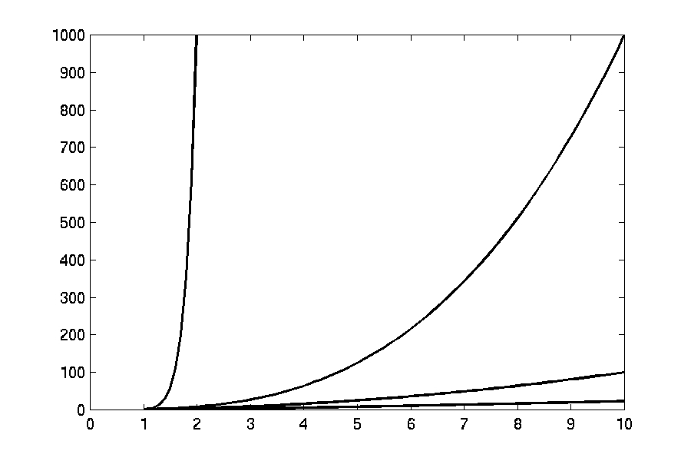
Complexity Graphs
n¹⁰
n³
n²
n log(n)

Slide 34
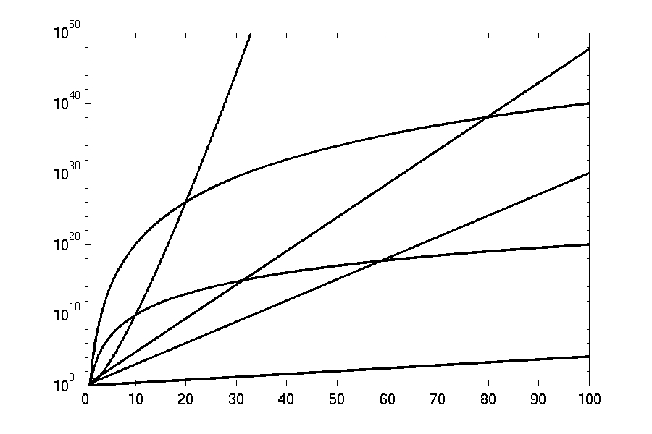
Complexity Graphs (log scale)
3^{n}
n^{n}
n²⁰
2^{n}
n¹⁰
1.1^{n}

Slide 35
Asymptotic Notations
O notation: asymptotic “upper bound”:
Ω notation: asymptotic “lower bound”:
Θ notation: asymptotic “tight bound”:

Slide 36
Asymptotic Notations
O-notation
O(g(n)) is the set of functions with smaller or same order of growth as g(n)
Examples:
T(n) = 3n²+10nlgn+8 is O(n²), O(n²lgn), O(n³), O(n⁴), …
T’(n) = 52n²+3n²lgn+8 is O(n²lgn), O(n³), O(n⁴), …

Slide 37
Asymptotic Notations
Ω - notation
Ω(g(n)) is the set of functions with larger or same order of growth as g(n)
Examples:
T(n)=3n²+10nlgn+8 is Ω(n²), Ω(nlgn), Ω(n), Ω(nlgn),Ω(1)
T’(n) = 52n²+3n²lgn+8 is Ω(n²lgn), Ω(n²), Ω(n), …

Slide 38
Asymptotic Notations
Θ-notation
Θ(g(n)) is the set of functions with the same order of growth as g(n)
* f(n) is both O(g(n)) & Ω(g(n)) ↔ f(n) is Θ(g(n))
Examples:
T(n) = 3n²+10nlgn+8 is Θ(n²)
T’(n) = 52n²+3n²lgn+8 is Θ(n²lgn)

Slide 39
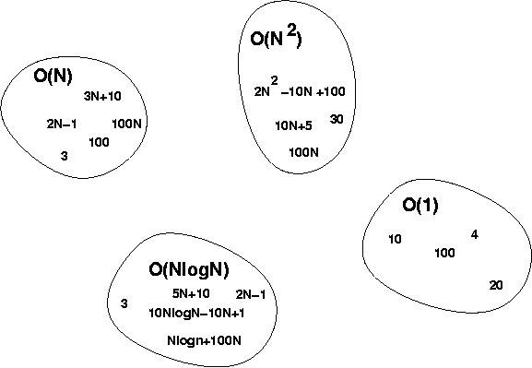
Big-O Visualization

Slide 40
Some Examples
Determine the time complexity for the following algorithm.
count = 0;
for(i=0; i<10000; i++)
count++;

Slide 41

Some Examples
Determine the time complexity for the following algorithm.
count = 0;
for(i=0; i<10000; i++)
count++;
$$O(1)$$

Slide 42
Some Examples
Determine the time complexity for the following algorithm.
count = 0;
for(i=0; i<n; i++)
count++;

Slide 43

Some Examples
Determine the time complexity for the following algorithm.
count = 0;
for(i=0; i<n; i++)
count++;
$$O(n)$$

Slide 44
Some Examples
Determine the time complexity for the following algorithm.
sum = 0;
for(i=0; i<n; i++)
for(j=0; j<n; j++)
sum += arr[i][j];

Slide 45
Some Examples
Determine the time complexity for the following algorithm.
sum = 0;
for(i=0; i<n; i++)
for(j=0; j<n; j++)
sum += arr[i][j];
O(n²)

Slide 46
Some Examples
Determine the time complexity for the following algorithm.
count = 0;
for(i=1; i<=n; i=i*2)
count++;

Slide 47
Some Examples
Determine the time complexity for the following algorithm.
count = 0;
for(i=1; i<=n; i=i*2)
count++;
O(lg n)

Slide 48
Some Examples
Determine the time complexity for the following algorithm.
sum = 0;
for(i=1; i<n; i=i*2)
for(j=0; j<n; j++)
sum += i*j;

Slide 49
Some Examples
Determine the time complexity for the following algorithm.
sum = 0;
for(i=1; i<n; i=i*2)
for(j=0; j<n; j++)
sum += i*j;
O(n lg n)

Slide 50
Some Examples
Determine the time complexity for the following algorithm.
sum = 0;
for(i=1; i<=n; i=i*4)
for(j=0; j<=n; j*=2)
sum += i*j;
Asympotic Tight Bound: Θ(lg n)
WHY?

Slide 51
Some Examples
Determine the time complexity for the following algorithm.
sum = 0;
for(i=1; i<n; i=i*2)
for(j=0; j<i; j++)
sum += i*j;

Slide 52
Some Examples
Determine the time complexity for the following algorithm.
sum = 0;
for(i=1; i<n; i=i*2)
for(j=0; j<i; j++)
sum += i*j;
Loose Upper Bound: O(n lg n)
Tight Upper Bound: O(n)
Asympotic Tight Bound: Θ(n)
WHY?

Slide 53
Some Examples
Determine the time complexity for the following algorithm.
char someString[10];
gets(someString);
for(i=0; i<strlen(someString); i++)
someString[i] -= 32;

Slide 54

Some Examples
Determine the time complexity for the following algorithm.
char someString[10];
gets(someString);
for(i=0; i<strlen(someString); i++)
someString[i] -= 32;
$$O(n2)$$

Slide 55

Types of Analysis
Is input size everything that matters?
int find_a(char *str)
{
int i;
for (i = 0; str[i]; i++)
{
if (str[i] == ’a’)
return i;
}
return -1;
}
Time complexity: $O(n)$
Consider two inputs: “alibi” and “never”

Slide 56
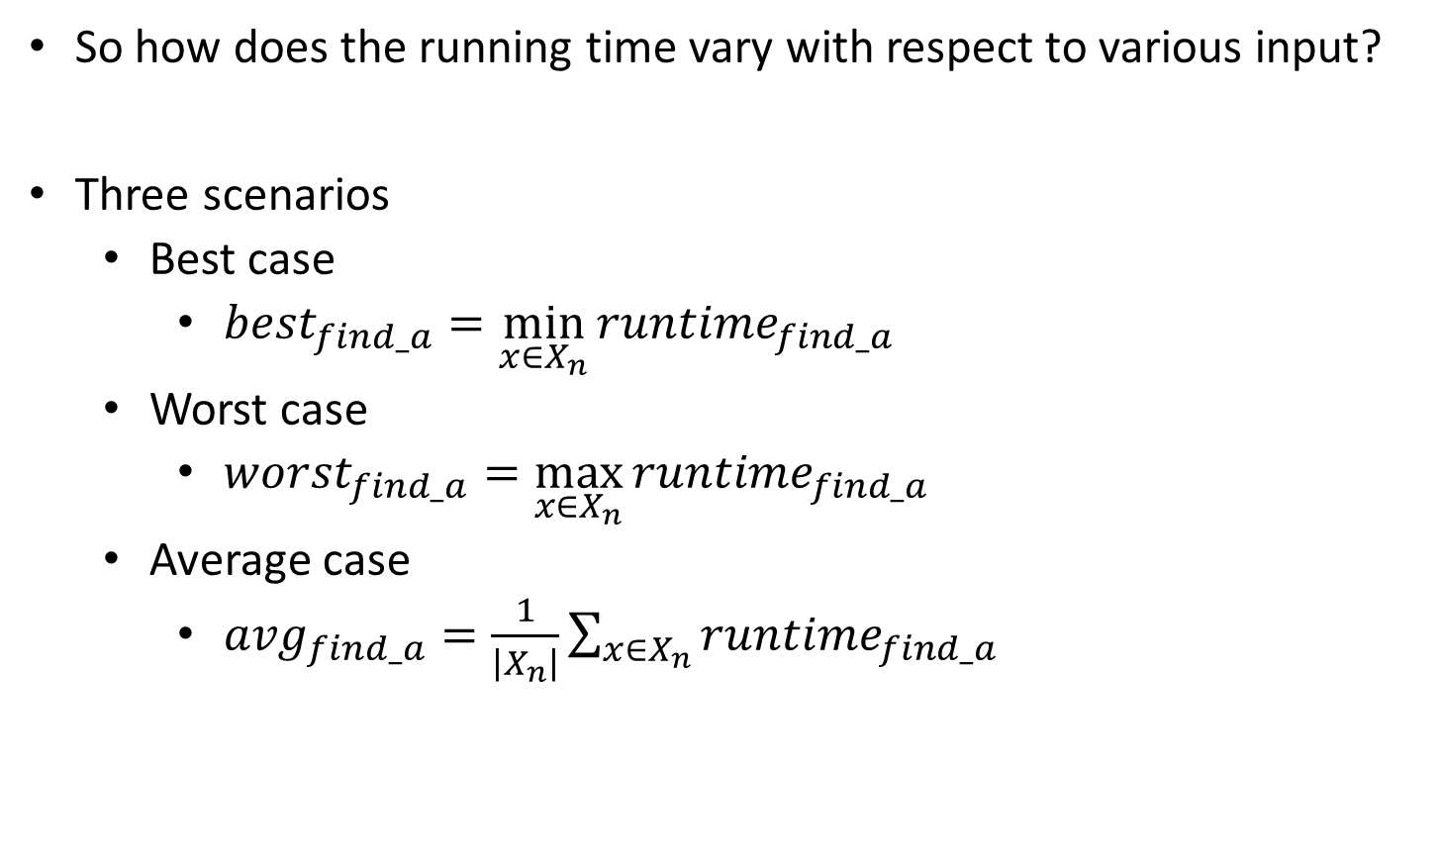
Types of Analysis
So how does the running time vary with respect to various input?
Three scenarios
Best case
$${best}_{find_a}=\min_{x∈X_{n}}{{runtime}_{find_a}}$$
Worst case
$${worst}_{find_a}=\max_{x∈X_{n}}{{runtime}_{find_a}}$$
Average case
$${avg}_{find_a}=\frac{1}{\left|X_{n}\right|}{\sum_{x∈X_{n}}{{runtime}_{find_a}}}$$

Slide 57
Types of Analysis
Worst-case: (usually done)
upper bound on running time
maximum running time of algorithm on any input of size n
Average-case: (sometimes done)
we take all possible inputs and calculate computing time for all of the inputs
sum all the calculated values and divide the sum by total number of inputs
we must know (or predict) distribution of cases
Best-case: (bogus)
lower bound on running time of an algorithm
minimum running time of algorithm on any input of size n

